Slide 1
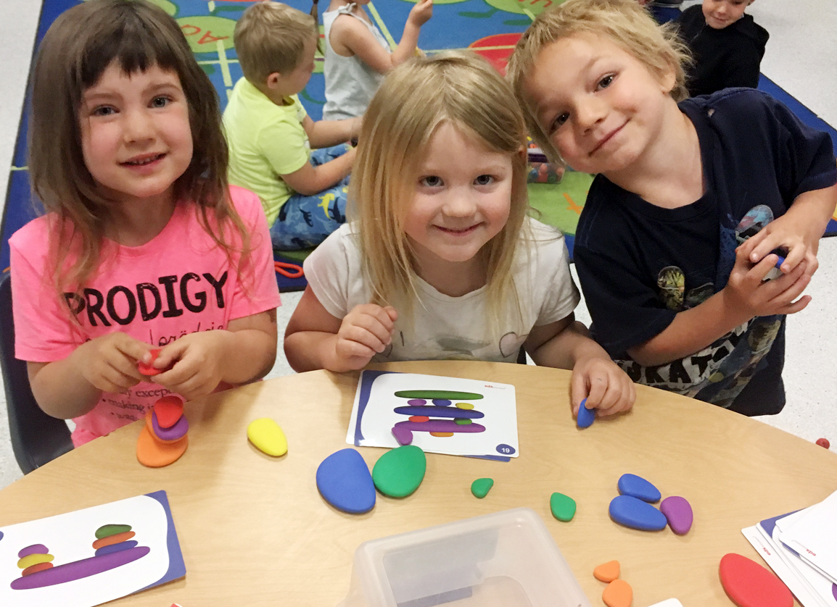
School District No. 83
(North Okanagan-Shuswap)
2021-22 preliminary annual Budget

Slide 2
Annual Budget Regulation
As per Section 110 of the School Act:
(2) boards must prepare an annual budget in the form and containing the content specified by the minister;
(3) Estimated expenditures and the annual budget must not exceed estimated revenues.
An annual budget must also be prepared in accordance with Section 23.1 of the Budget Transparency and Accountability Act and Financial Administration Act of the Province of British Columbia.

Slide 3
Annual Budget Cycle
The preliminary budget is based on enrolment projections provided by districts.
  Mid-February – enrolment projections for the following September are provided to the Ministry
  March 15th – preliminary grant provided by the Ministry (based on projected enrolment)
  April/May – budget development process takes place – must be a balanced budget
  June – preliminary budget approved by Board by bylaw – must be submitted to Ministry by June 30th (per School Act)

Slide 4
Annual Budget Cycle
The final budget is based on actual enrolment reported to the Ministry at September 30th.
  September 30th - actual enrolment reported to Ministry (1701 report)
  December 15th – final recalculated grant provided (based on actual enrolment)
  February - amended annual budget approved by Board by bylaw– must be submitted to Ministry by February 28th (as per the School Act)

Slide 5
Sources of Revenues
Operating Funds | Special Purpose Funds | Capital Funds
Ministry of Education Operating Grant Block Base per Student Allocation Unique Student Unique District Funding Protection/Enrolment Decline Pay Equity Student Transportation Fund Other Provincial Grants Local Sources of Revenues Other Provincial Grants Local Education Tuition Agreements Investment income Rentals and Leases Other Revenues | Ministry of Education Classroom Enhancement Fund Learning Improvement Fund Community LINK Annual Facility Grant (Operating portion) StrongStart Ready Set Learn French Federal Grant (OLEP) First Nation Student Transportation Child/Youth Mental Health Grant Changing results for Young Children School Generated Funds Scholarship and Bursaries | Ministry of Education Annual Facilities Grant (Capital portion) Seismic Mitigation Building Expansion Building Replacement Bus Replacement School Enhancement, Carbon Neutral Capital Plan Playground Equipment Funding Local Capital Reserves Sale of Capital Assets Operating Surpluses

Slide 6
What are Special Purpose Funds?
Special Purpose Funds are grants provided by the Ministry of Education or other sources that have been designated for specific purposes.
These funds are intended to be spent within the year they are provided.
Any unspent special purpose funds must be held in trust and be shown as unspent deferred revenues on our year end financial statements.

Slide 7
2021-22 Special Purpose Funds

Slide 8
What are Capital Funds?
MOE Capital Funds
    Allocated based on the District’s 5-Year Capital Plan Submission, which is adopted by the Board and submitted to the Ministry prior to June 30 each fiscal year:
    Major Capital (>$2M) provided to acquire land, build schools, or to fund significant renovations or expansions to existing schools
    Minor Capital (<$2M) provided for HVAC, large roofing projects, and small additions/renovations
    Bus Replacement
    School Playground Grants
    Annual Facility Grant provided annually in March based on #/size of open school sites; intended for general repair and maintenance
Local Capital Reserves
    proceeds from asset disposal
    generated through Board approved transfers of operating surplus

Slide 9
2021-22 MoE Capital Funds

Slide 10
Operating Funds
Boards hold autonomy and responsibility to allocate operating funds as they deem appropriate within their individual districts.
Operating Grant calculations are based on the district’s forecasted student enrolment, and were announced by the Ministry of Education on March 13, 2021.
Other operating grant projections are high-level estimates, and based on historical information and known or anticipated changes expected in the future.

Slide 11

Budget Committee
To advise and assist with the 2021-22 Operational Budget development, the Board accessed its Budget Committee. The committee consists of representation from all partner groups:
    Teachers
    Support staff
    First Nations
    Principals and Vice Principals
    Parents
    District Staff
The purpose of this working group is to provide the Board with representative advice on budget issues and implications of proposed changes, and to allow for an interactive forum for open communication and understanding of the budget.

Slide 12


School District No. 83 Strategic Plan Goals
$$ BUDGET $$
STUDENTS FIRST
  Student success is our priority every day.
CULTURE OF HEALTH AND WELLNESS
  Students and staff are healthy,
  and connected to the learning community.
ORGANIZATIONAL EFFICIENCY
Decisions and actions are clear, purposeful and reasonable.

Slide 13
2021-22 Ministry of Education Block Funding Level Changes

Slide 14
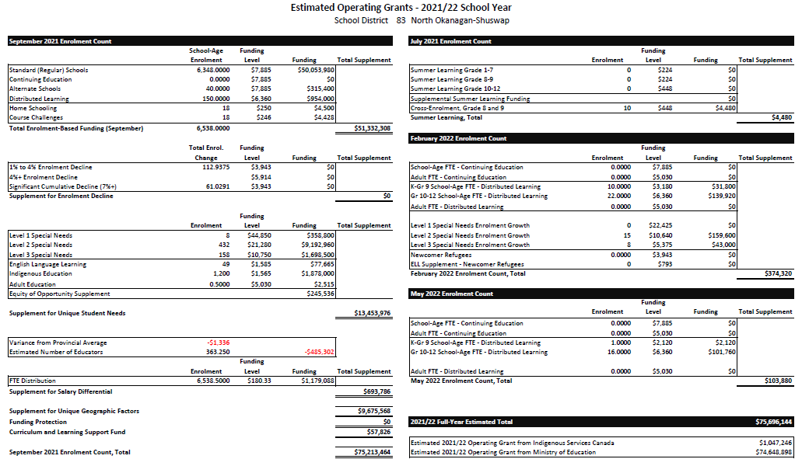

Slide 15
2021-22 Projected Operating Revenues % by Source

Slide 16
2021-22 Preliminary MoE Operating Grant Block

Slide 17
2021-22 Preliminary Revenue Summary

Slide 18
How do we plan to allocate our operating funds by expense?
2021-22 EXPENDITURES

Slide 19
2021-22 – TEACHERS (CORE)

Slide 20
2021-22 – TEACHERS (DISTRICT SUPPORT)

Slide 21
2021-22 – PRINCIPALS/VICE PRINCIPALS

Slide 22
2021-22 – OTHER PROFESSIONALS

Slide 23
2021-22 – SUPPORT STAFF (SCHOOLS)

Slide 24
2021-22 – SUPPORT STAFF (DISTRICT)

Slide 25
2021-22 – SUPPORT STAFF (DISTRICT)

Slide 26
2021-22 – SUPPORT STAFF (OPERATIONS)

Slide 27
2021-22 Cost Pressures/Anticipated Savings
Benefit Premiums $442,000
Wage/Compensation Improvements $1,080,390
    Teachers $640,000
    CUPE Support Staff $290,140
    Principals and Vice Principals $105,600
    Other Professionals $44,650

Slide 28
2021-22 Cost Pressures/Anticipated Savings
General Enrolment Growth $82,020
    School Supplies Allocations $11,800
    Education Outreach Program $22,210
    International Student Program $48,010
Identified Student Growth $820,000
Career Education/Trades Growth $67,500

Slide 29
2021-22 Cost Pressures/Anticipated Savings
General Inflation $77,800
Utilities $24,000
Custodial Services $549,600
  Custodial Salaries/Benefits $490,000
  Custodial Supplies and Equipment $59,600
Telephone Land Lines ($29,000)

Slide 30
2021-22 Additional Equipment Refresh
Bus Engine Replacements $40,000
Student Transportation Routing $126,500
  Tyler Drive Tablets $102,500
  Routing/Planning/Tracking Software $24,000
Zero Turn Mower and Trailer $20,000

Slide 31
2021-22 Proposed Initiatives
Inclusive Education
  Inclusion Resource Teacher ($104,310)
    Supporting school teams with designing inclusive programs for students with complex needs
    CBIEP goal bank development, training and mentorship for new LRTs
    Transportation of students with complex needs
    Adapted Aquatics/Equine Therapy
    CEA Pro-D

Slide 32
2021-22 Proposed Initiatives
Instruction and Curriculum
  1. Seamless Transitions Pilot Project – ECE Worker ($50,000)
        Before and after school childcare in schools
        Match Ministry of Education funding ($50,000)
        Support for Kindergarten students during the school day (added benefit)
  2. Transforming Assessment K-12 – District Learning Plan ($197,756)
        Transforming Assessment K-12:
          “Giving Students a Say” Secondary Assessment with Myron Dueck
          K-8 Communicating Student Learning
        Curriculum
          Continued work with National Math leader, Dr. Peter Liljedahl
          School-based data conversations
          Heggerty Phonological Awareness Program (Kgn/Gr. 1)
          Powerful Writing Structures, Adrienne Gear
          School Improvement Plans with Observable Impact, Cale Birk
          Communities of Practice (professional learning & inquiry series)
          Teacher mentorship & Induction
  3. Physical Literacy ($40,000 grant)
        Staff training, school champions, release time.

Slide 33
2021-22 Proposed Initiatives
Business/Operations
Student Information System (SIS) Level 1 Support Position
We plan to implement at least two additional modules in MyEd for September 2021;
Family Portal and Online Registration
Family Portal will replace Parent Connect used with CIMS (old SIS)
Online Registration is new to MyEd and will change SD83 business cycles and practices
MyEd has proven to be more labour intensive and time consuming that CIMS
Other districts have told us to increase the district level support for these modules
Current L1 position supports approximately 1500 users. We will be adding 10,000 new users
New modules and business practice changes will continue
Adding of new modules in MyEd and changing business cycles and processes, that effect all areas of the district, will continue into the foreseeable future keeping staff at or over capacity. In an effort to address work load concerns, the district is proposing an addition of a .5 FTE SIS Level 1 support staff position

Slide 34
2021-22 Draft Operating Expenses

Slide 35
2020-21 Projected Operating Surplus/(Deficit)

Slide 36
2021-22 DRAFT Operating Budget Summary

Slide 37
Request for Feedback
Online Survey
Should you wish to share your views on the proposed budget considerations, you are invited to complete the online survey that has been emailed to all parents, guardians, and stakeholders, or can be accessed via our website.
This survey is open from today, Monday, May 10th through to 12:00pm Tuesday, May 18th, 2021.
Individuals wishing to provide written submissions are asked to email them to swood@sd83.bc.ca before end of day on Monday, May 17th.

Slide 38
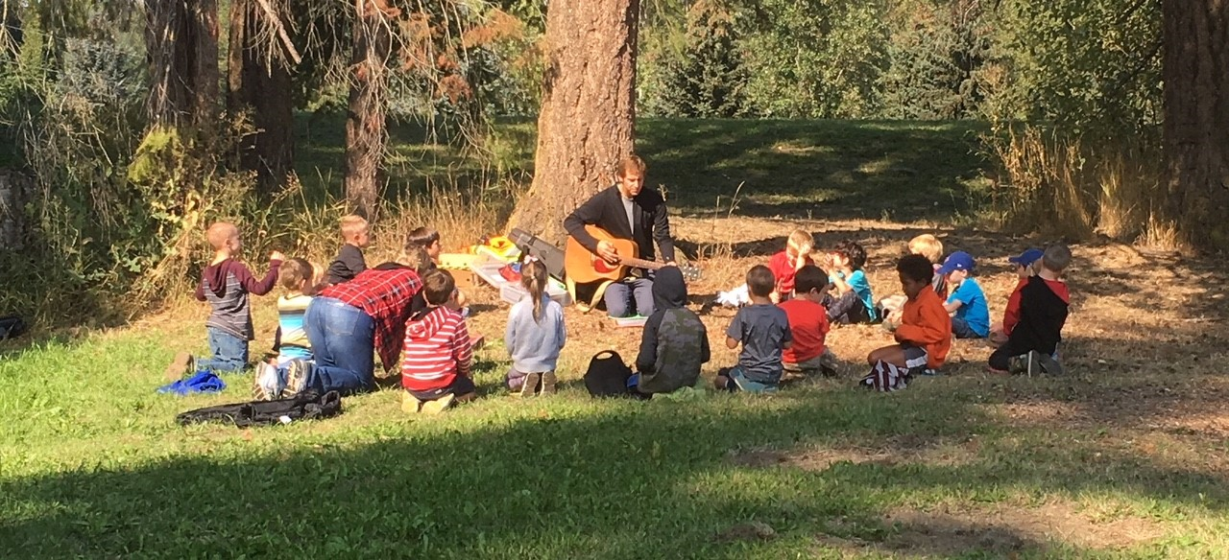
QUESTIONS & DISCUSSION

